Slide 1
CS 74 Machine Learning
Amazon Reviews: Grocery and Gourmet Food Ratings
Group 7: Alex Bakos, Daniel Akili, Jeff Cho, Sam Wang, Scott Crawshaw
Notes:
Because of some legitimate requests, I have decided to extend the deadline for all teams to 1159pm ET on Sunday November 1. Here is what we expect to receive from you.
The code you used for your class project along with info on any libraries etc that you used
An output file with the predictions generated by your best predictive model on the test data in the same format as was required for Deliverable #3.
A Powerpoint Slide deck consisting of the following slides (you may not exceed the specified number of slides):
Cover slide with a list of team members and the Amazon Reviews dataset your team analyzed
One slide summarizing the features you used in deliverable #3.
Upto two slides summarizing new features you tried after deliverable #3.
One slide summarizing the approach(es) you used in deliverable #3.
Upto two slides summarizing new approaches you tried after deliverable #3 and the performance of your methods in 10-fold cross validation.
One final “Credits” slide with a table specifying the various tasks performed on your project and who contributed to which task.

Slide 2
Old Features
All features were gathered on a per product basis
Combined reviewText for all reviews of the same product into one string, processed it into a TF-IDF bag of words
Fed into a RF model that outputs a probability of awesomeness based on review bodies
Combined review summaries of the same product into one string, processed it into a TF-IDF bag of words
Fed into model(s) that outputs probability of awesomeness based on summaries

Slide 3
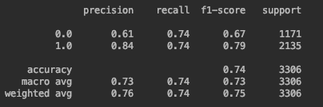
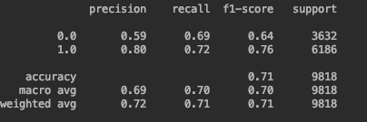
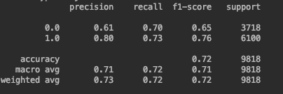
Old Approach: Stacked predictions from two RF models into an SVM
Final Gaussian SVM
Random Forest on review bodies
Random Forest on review summaries
Number of Reviews per Product

Slide 4
New Features
Added more models to stack below our Final SVM:
Multinomial Naive Bayes
GradientBoostingClassifier
AdaBoost
Tried XGBoost - ended up removing because somewhat redundant with other boosting methods
Tried stemming - didn’t change f1
Hyperparameter Optimization:
RandomForest - n_estimators, max_features, bootstrap, max_depth, min_samples_split, min_samples_leaf
AdaBoost - n_estimators, learning_rate
Gradient Boosting Classifier - learning_rate, n_estimators, min_samples_split
SVM - kernel, C, shrinking
TFIDF vectorizer - looked at n_grams and stop words
Interestingly, removing stop_words worsened f1 by 0.01-0.02

Slide 5
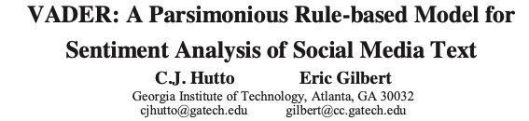
New Approaches
Up to this point, all of our approaches had been on a per product basis
By combining the reviews/summaries of each product into one string, there’s some information lost
VADER - an open source rule based model that combines qualitative and quantitative approaches to analyze a document’s sentiment
Vader’s SentimentIntensityAnalyzer takes in a review/sentence and outputs a 4 dimensional sentiment score
Ex: “The phone is super cool.” -> 'neg': 0.0, 'neu': 0.326, 'pos': 0.674, 'compound': 0.7351
For each product: We run SentimentIntensityAnalyzer on each review and each summary.
We put the 25th, 50th, and 75th percentiles of all four output scores as features in our final SVM, the idea being to capture the distribution of sentiments for a specific product.

Slide 6
VADER Scores example:
We look at the distribution of scores for both the summaries of a given product and the reviews of a given product
VADER’s sentiment intensity analyzer outputs a four dimensional sentiment vector [‘pos’, ‘neg’, ‘neu’, ‘compound’], and we look at the distribution of each of these four values for both the summaries and the review bodies
The column labels for the VADER score distributions of each product are shown below:
compound25Text, compound25Summary, compound50Text, compound50Summary, compound75Text, compound75Summary, pos25Text, pos25Summary, pos50Text, pos50Summary, pos75Text, pos75Summary, neg25Text, neg25Summary, neg50Text, neg50Summary, neg75Text, neg75Summary, neu25Text, neu25Summary, neu50Text, neu50Summary, neu75Text, neu75Summary
‘compound25Text’ for example is the 25th percentile of the VADER ‘compound’ scores for all of the reviewTexts of a product, ‘compound25Summary’ is the 25th percentile compound score for all of a product’s review summaries

Slide 7
Final Approach
Our final SVM took in 33 features for each product:
8 features with the predictions from the 4 types of inner models (2 models of each type: 1 on the summaries, 1 on the review bodies)
In between 0 and 1, these features represent a product’s the probability of awesomeness based on a certain model
24 features for the distribution of VADER scores
A feature for the number of reviews (performed feature scaling so in between 0-1)
We used sklearn’s RecursiveFeatureElimination function to search for the subset of features that leads to the best performance by our final SVM, but the difference in f1 between the best subset of features and all features was really small ( < 0.001)

Slide 8
Model Performances after hyperparameter optimization
Model | Precision | Recall | F1
RandomForest on bodies | 0.75 | 0.77 | 0.75
RandomForest on summaries | 0.77 | 0.78 | 0.77
MultinomialNB on bodies | 0.70 | 0.73 | 0.70
MultinomialNB on summaries | 0.75 | 0.77 | 0.75
AdaBoost on bodies | 0.72 | 0.73 | 0.72
AdaBoost on summaries | 0.75 | 0.77 | 0.75
GBC on bodies | 0.76 | 0.77 | 0.76
GBC on summaries | 0.77 | 0.79 | 0.78
SVM with just Vader score distributions | 0.70 | 0.73 | 0.71
SVM with the Vader Score distributions and all 8 inner model predictions | 0.83 | 0.83 | 0.83
macro avg*

Slide 9
Credits
Name | Tasks
Samuel Wang | Multinomial Naive Bayes, hyperparameter optimization (RF, ADA, GBC, SVM), Sentiment Score for reviewText using Naive Bayes, Powerpoint Presentation
Daniel Akili | 10-fold cross validation, SVM at the end, data processing, Powerpoint Presentation
Jeffrey Cho | 10-fold cross validation, SVM at the end, data processing, Powerpoint Presentation
Alexander Bakos | AdaBoost, Gradient Boosting Classifier, Random Forest, Vader scores, Final SVM Model, Powerpoint Presentation
Scott Crawshaw | Vader scores, Preprocessing of data (combining strings of reviews, making sure there’s one row per productID), Final SVM help, panda data processing, TFIDF hyperparameter optimization

